Slide 1


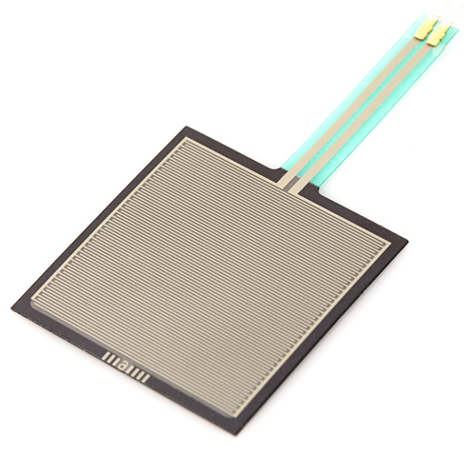
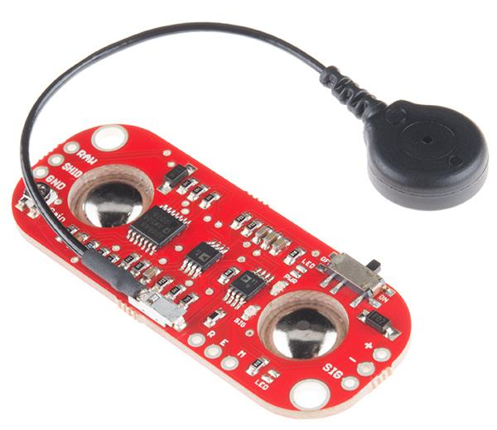
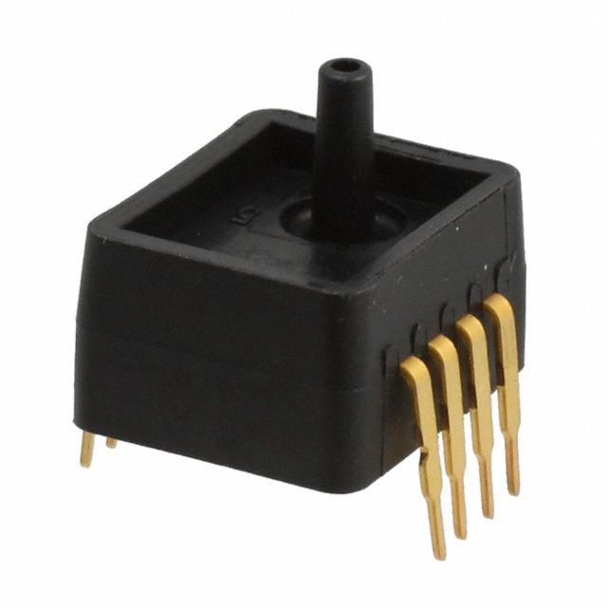


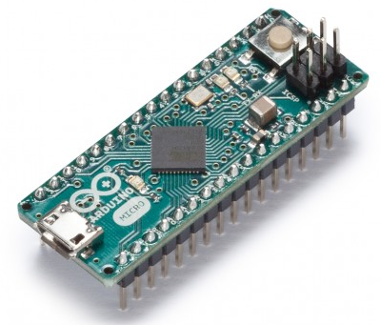
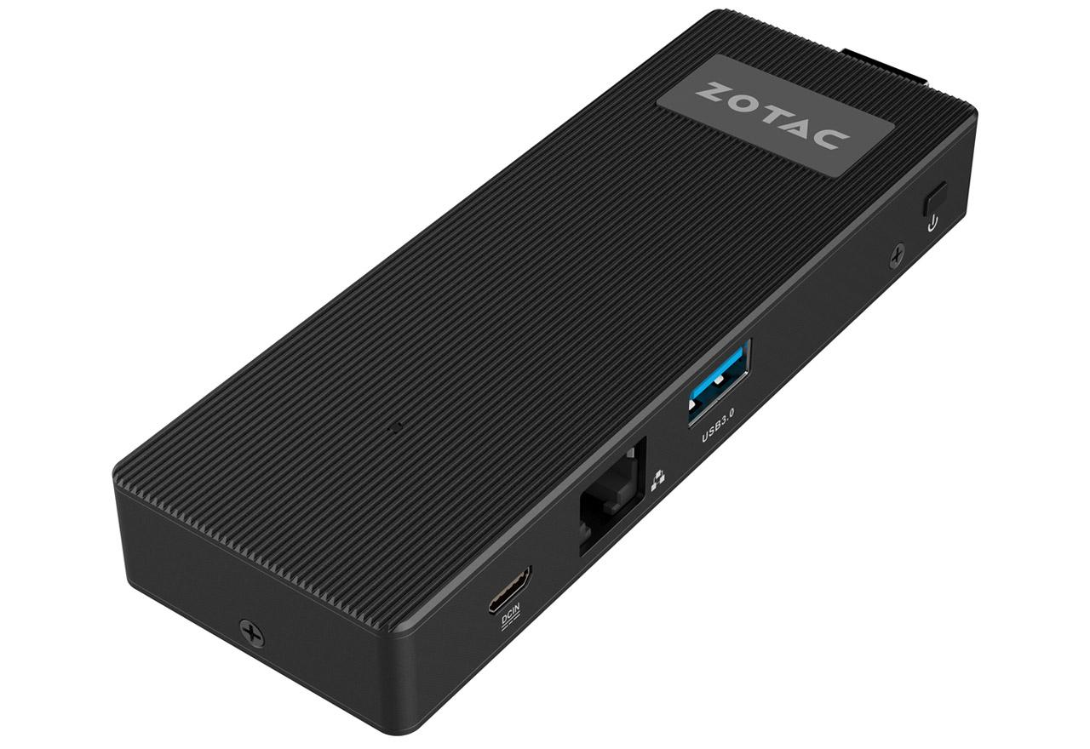
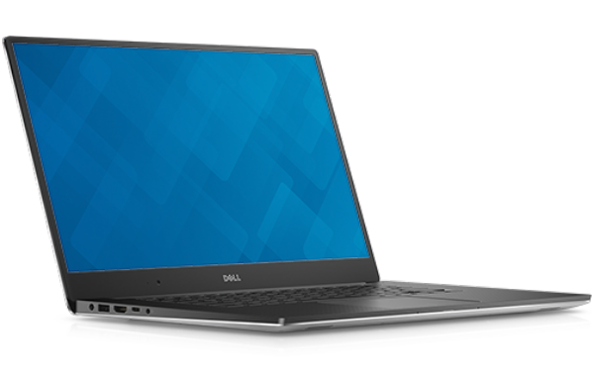

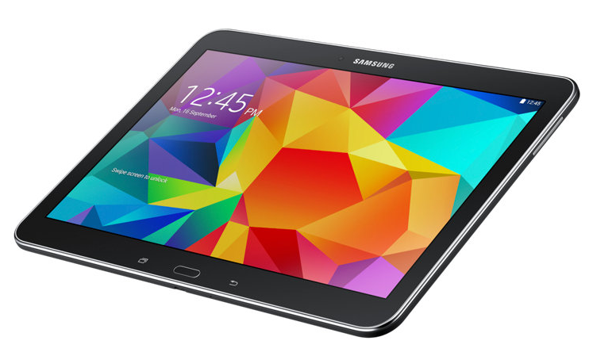
Electrical Team Progress
FSRs
EMGs
Gauges
ExoSuit Logic Diagram
A0, A1, A2, A3
Voltage Divider
Micro-B
A4, A5, A6, A7
A8, A9, A10, A11
Arduino Micro
USB-A
Zotac ZBOX PI223
ADC Pins
Wi-Fi

